Slide 1
Web-Based Alumni Association Platform for JU PMSCS Program
Final Defense
Student Id: CSE202502079
Name: Al-MAMUN
Intake: Summer 2025
Presenter
Notes:
NOTE:
To change the image on this slide, select the picture and delete it. Then click the Pictures icon in the placeholder to insert your own image.

Slide 2
Contents
Introduction
Related Work
Problem Statement
Project Questions & Objectives
System Architecture
Conceptual Flow
System/Prototype Development
System Modules
Database Design
Working Process
Discussion
Contributions & Significance
Limitations
Conclusion & Recommendations
Future Work
References

Slide 3
Introduction
Background of the Study
Alumni networks play a vital role in support connections between graduates and their institutions.
In many universities, alumni information is distributed across different platforms such as social media and informal groups.
There is no centralized system to manage alumni data, communication, and engagement activities.
This creates difficulty in maintaining long-term relationships between alumni and current students.
Motivation & Importance
To bridge the communication gap between alumni and students.
To create a structured platform for professional networking.
To simplify job sharing and career opportunities within the university community.
To digital event management such as seminars, workshops, and reunions.
11/07/2026

Slide 4
Introduction
Scope:
Focused on JU PMSCS program alumni and students
Web-based, accessible from any device
Covers core modules: jobs, events, networking, and directory
Objectives:
Develop a centralized alumni platform
Enable alumni registration and profile management
Provide job posting and application system
Simplify communication through forum and events
Expected Contributions
A fully functional alumni management system. Improved alumni-student interaction. Digital solution for job sharing and event management. Scalable system that can be extended to other departments.
11/07/2026

Slide 5
Related Work
Overview of Related Work
Existing platforms for alumni interaction are often fragmented and lack proper structure. Social media platforms like Facebook groups are widely used but do not provide organized data management or academic-focused features. Although some universities have dedicated alumni portals, many of them offer limited functionality and suffer from poor user experience.
Key Theories, Models, or Frameworks
Web-Based Information System Model: Enables centralized management of user data, communication, and services through an online platform.
3-Tier Architecture Model: Divides the system into presentation, application, and data layers, ensuring scalability, maintainability, and security.
Social Networking Model: Supports user interaction, collaboration, and information sharing within a connected community.
Extension of This Work
This study improves upon existing systems by integrating multiple features such as job postings, event management, forums, and alumni directories into a single unified platform. It specifically targets the JU PMSCS program to ensure contextual relevance and efficiency. Additionally, it replaces unstructured communication methods with a structured, database-driven system while enhancing usability and accessibility through a modern web-based interface.
11/07/2026

Slide 6
Problem Statement
Problem Statement
Alumni information is currently dispersed across multiple platforms such as social media, emails, and informal groups, resulting in poor data organization and accessibility. There is no centralized system to manage alumni profiles, job opportunities, and events in a structured manner. As a result, communication between alumni and current students remains limited, and valuable networking and job-sharing opportunities are not effectively utilized.
Importance of the Problem
This issue significantly impacts both students and institutions. Weak alumni student connections reduce career guidance and employment opportunities for students. At the same time, universities struggle to maintain long-term engagement with their graduates. The reliance on manual or unstructured systems increases the risk of data loss, inefficiency, and missed collaboration opportunities, ultimately limiting knowledge sharing within the academic community.
Research Gap and Need
Existing platforms such as social media and professional networking sites are not tailored to specific universities and fail to provide integrated solutions. Most available systems do not combine alumni management, job portals, event handling, and communication features within a single platform. Additionally, no dedicated system currently exists for managing JU PMSCS alumni effectively.
Need for the Study
There is a clear need for a centralized, structured, and web-based alumni platform that enhances communication, supports networking, and promotes career development for both alumni and current students.
11/07/2026

Slide 7
Project Questions & Objectives
Research Questions
How can alumni and students be effectively connected?
How can job opportunities be shared efficiently?
How can event management be digitalized?
How can a structured alumni database be maintained?
Main Objective:
Develop a centralized alumni association platform
Specific Objectives:
Enable alumni registration and profile management
Provide job posting and application system
Facilitate communication through forum
Manage events and reunions digitally
11/07/2026

Slide 8
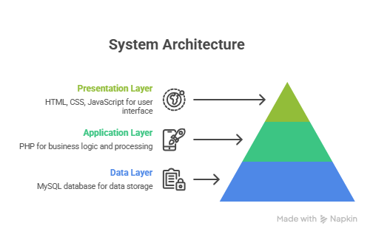
System Architecture
The system follows a 3-tier architecture:
11/07/2026

Slide 9
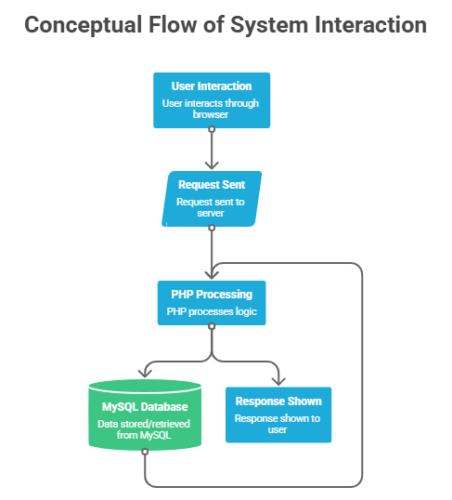
Conceptual Flow
User interacts through browser
Request sent to server
PHP processes logic
Data stored/retrieved from MySQL
Response shown to user
11/07/2026

Slide 10
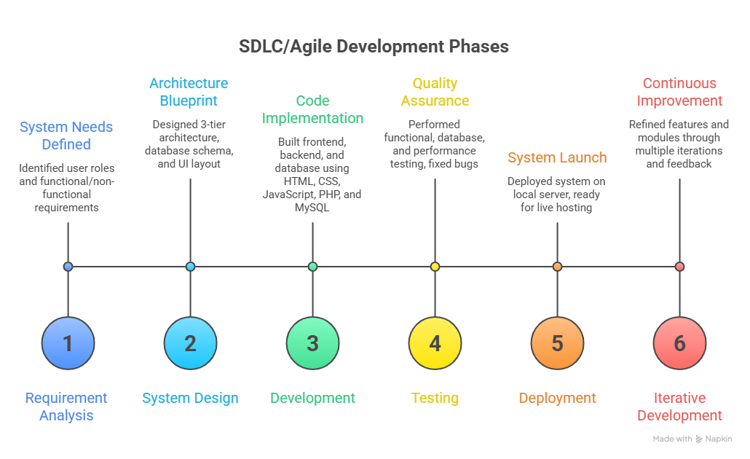
System/Prototype Development
Development Model: SDLC / Agile
Phases:
Requirement Analysis
System Design
Development
Testing
Deployment
Technologies Used:
Frontend: HTML, CSS, JavaScript
Backend: PHP
Database: MySQL
Tools:
XAMPP Server
GitHub
11/07/2026

Slide 11
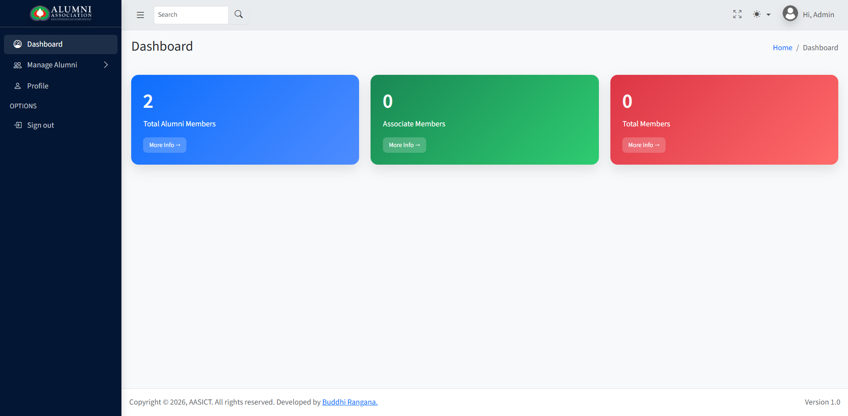
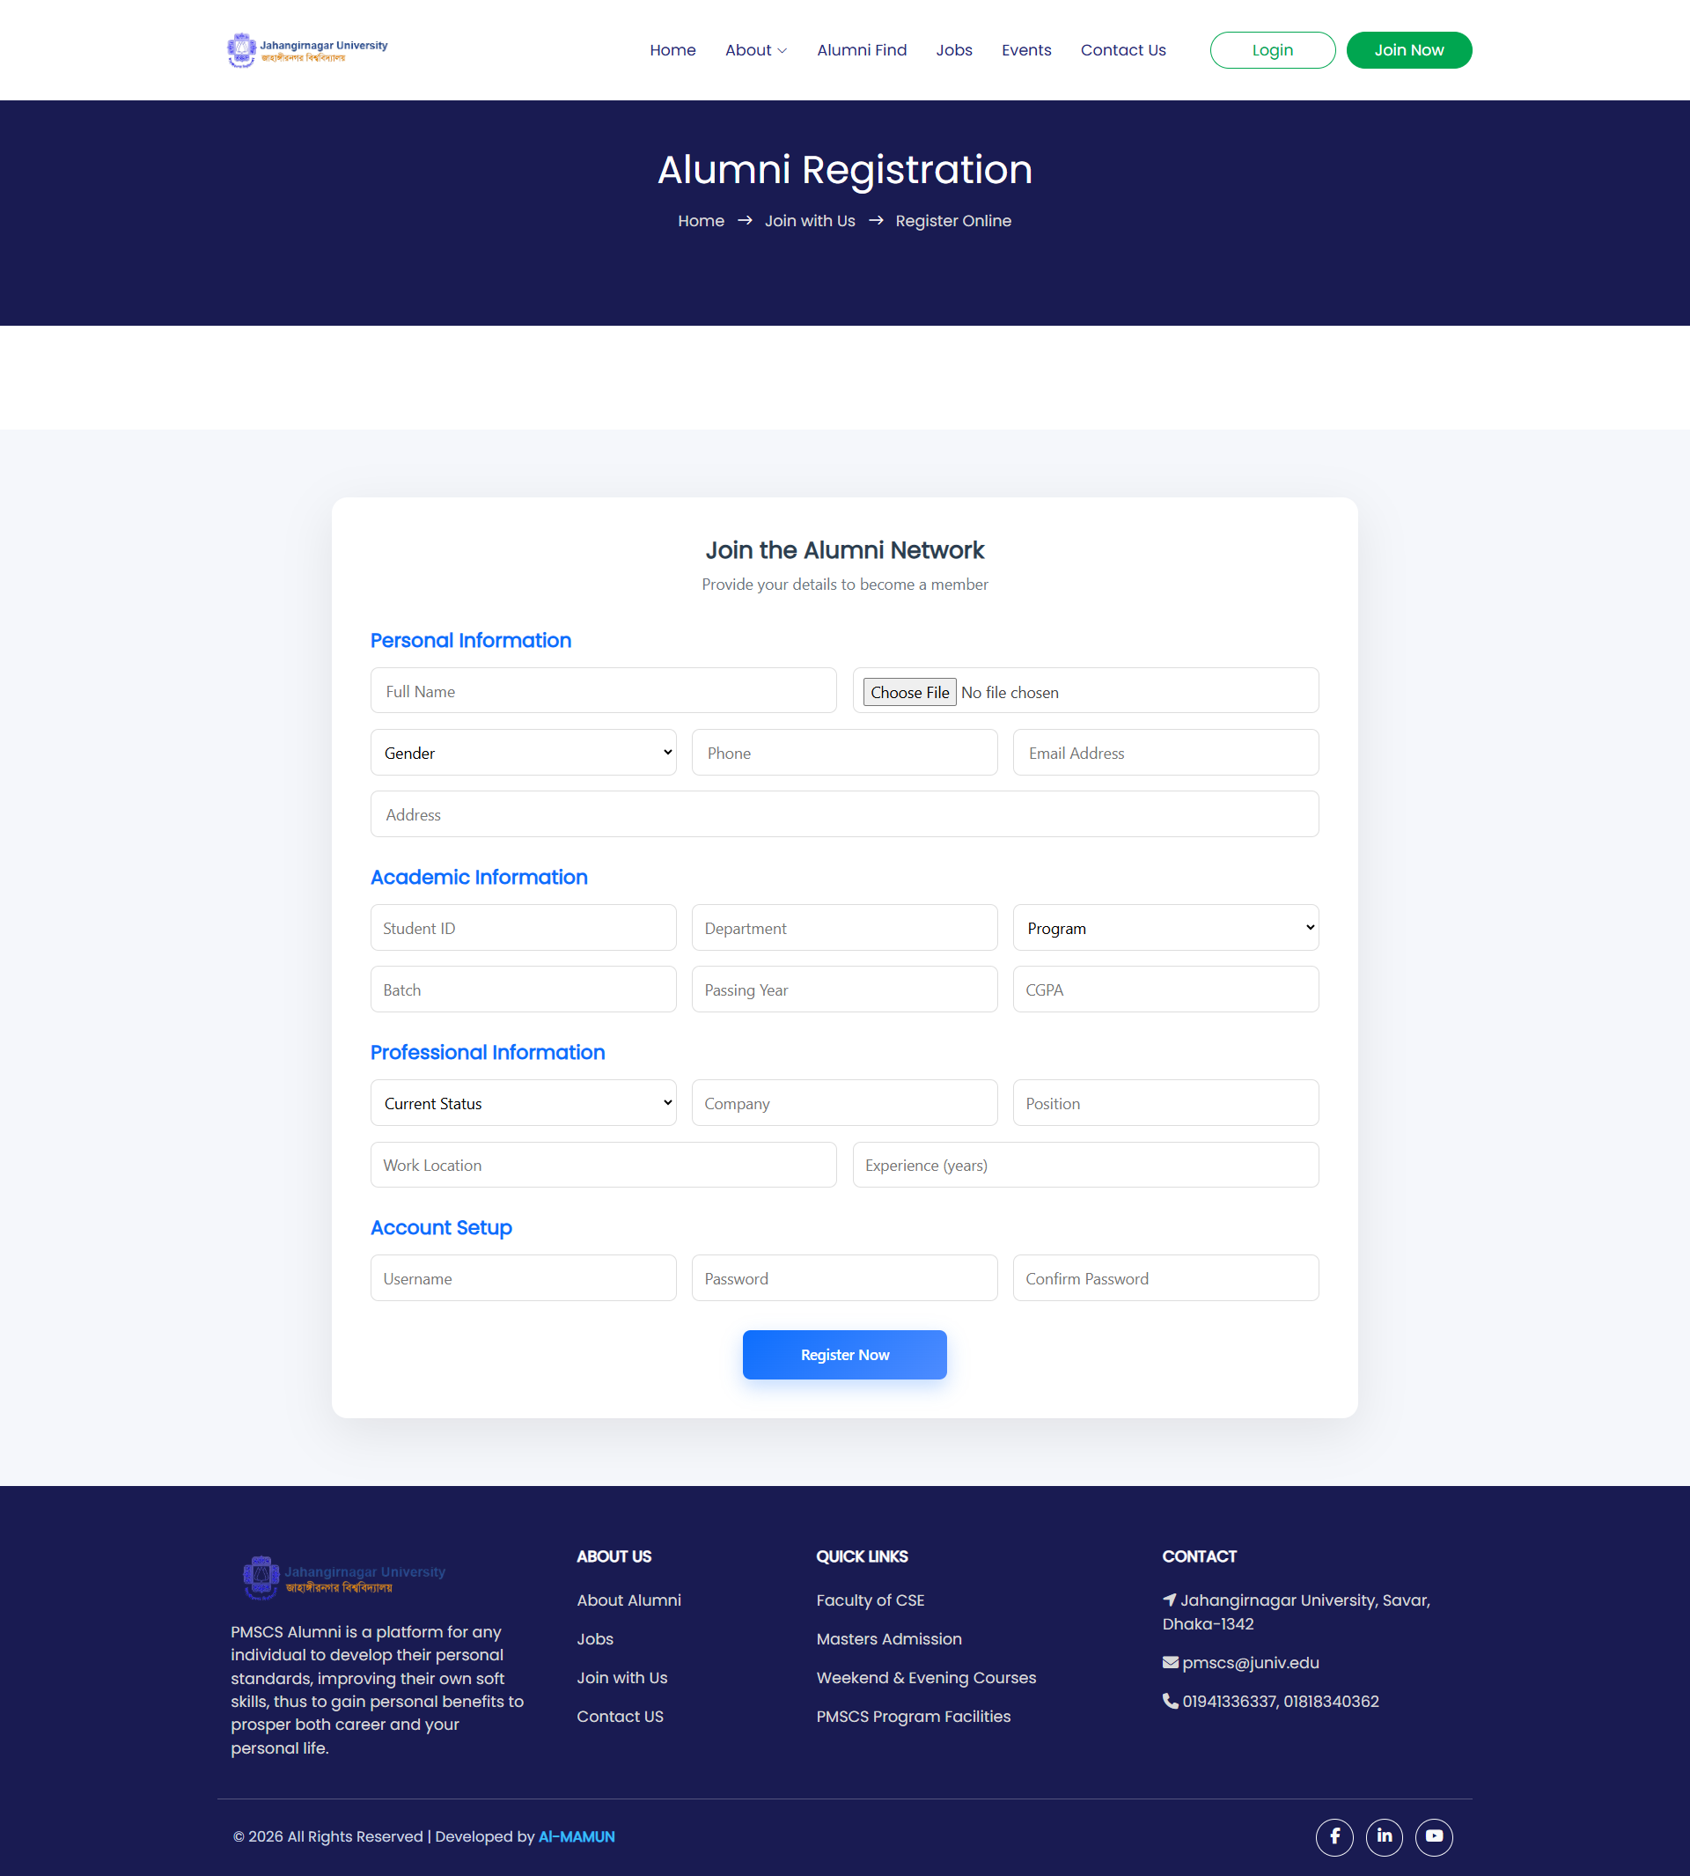
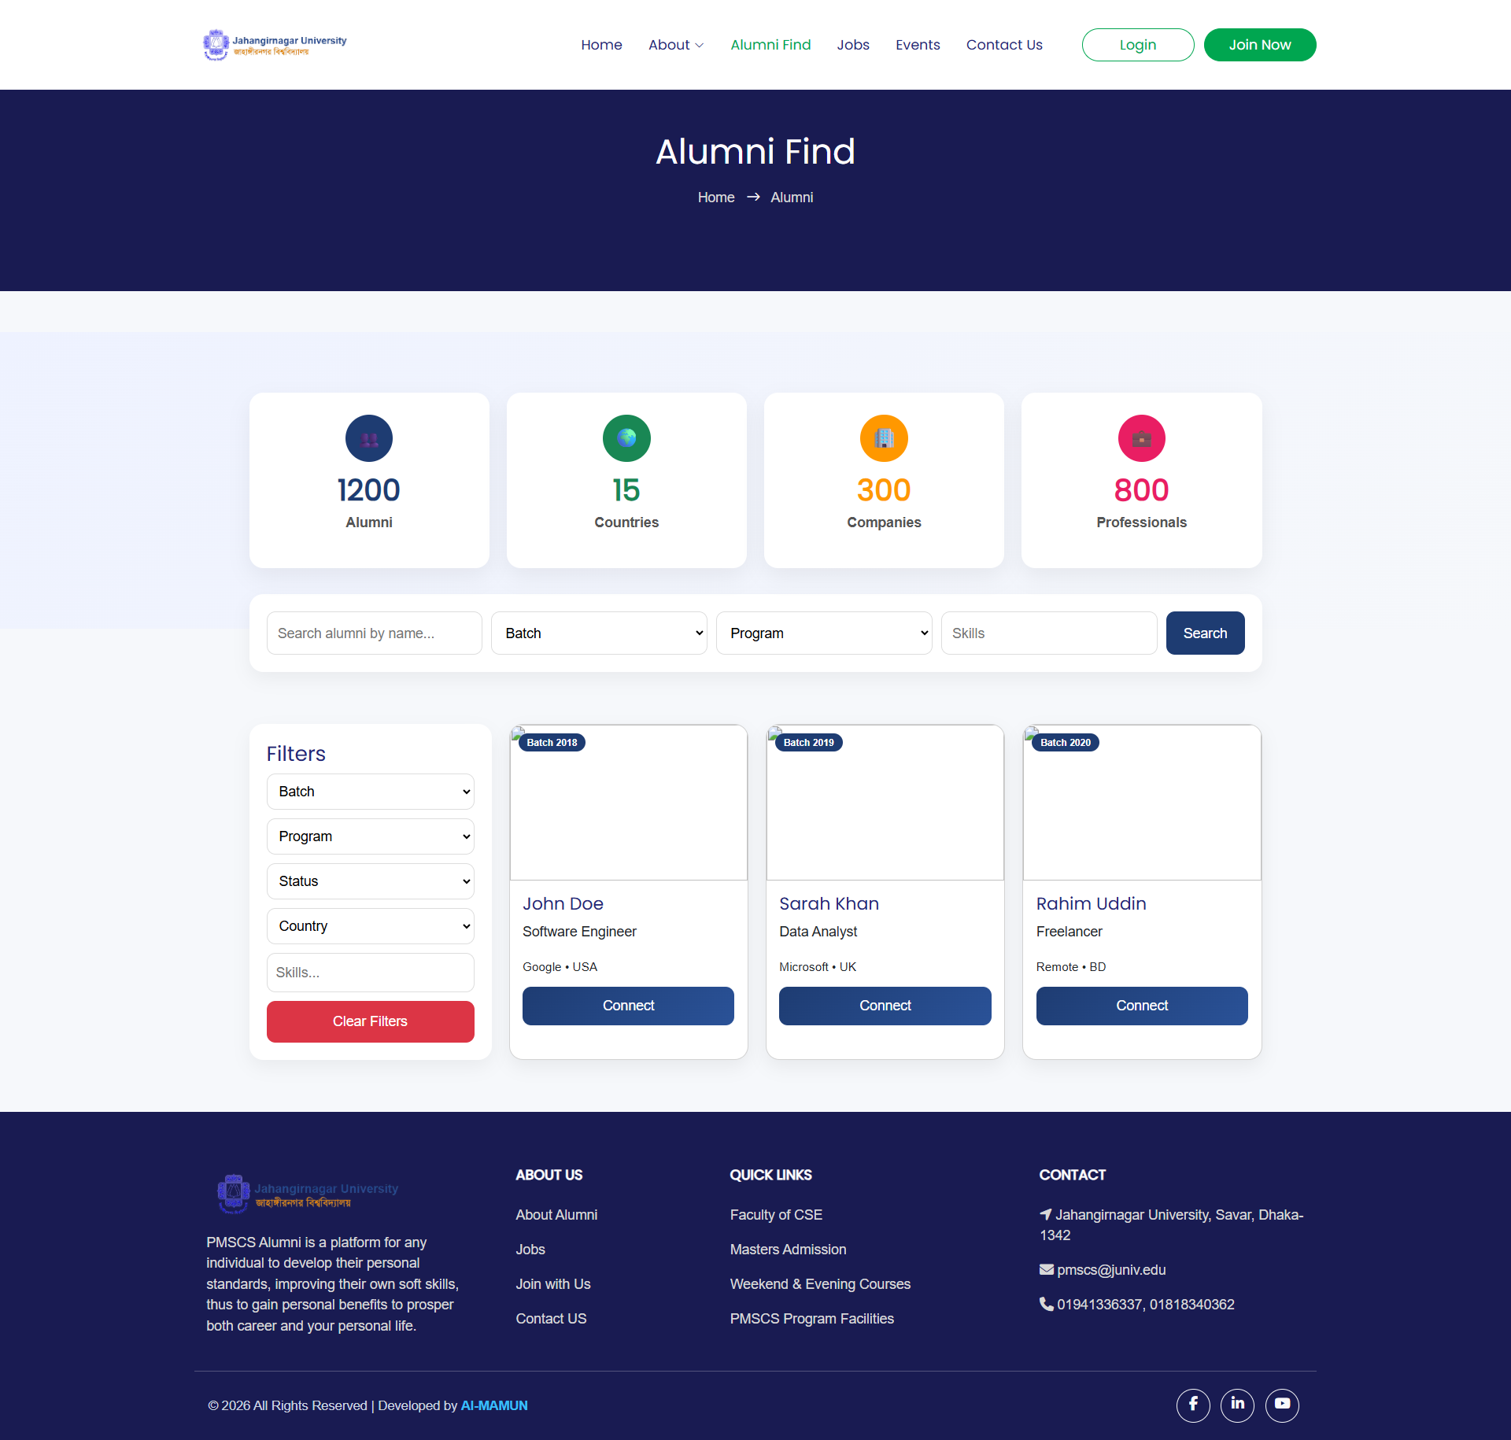
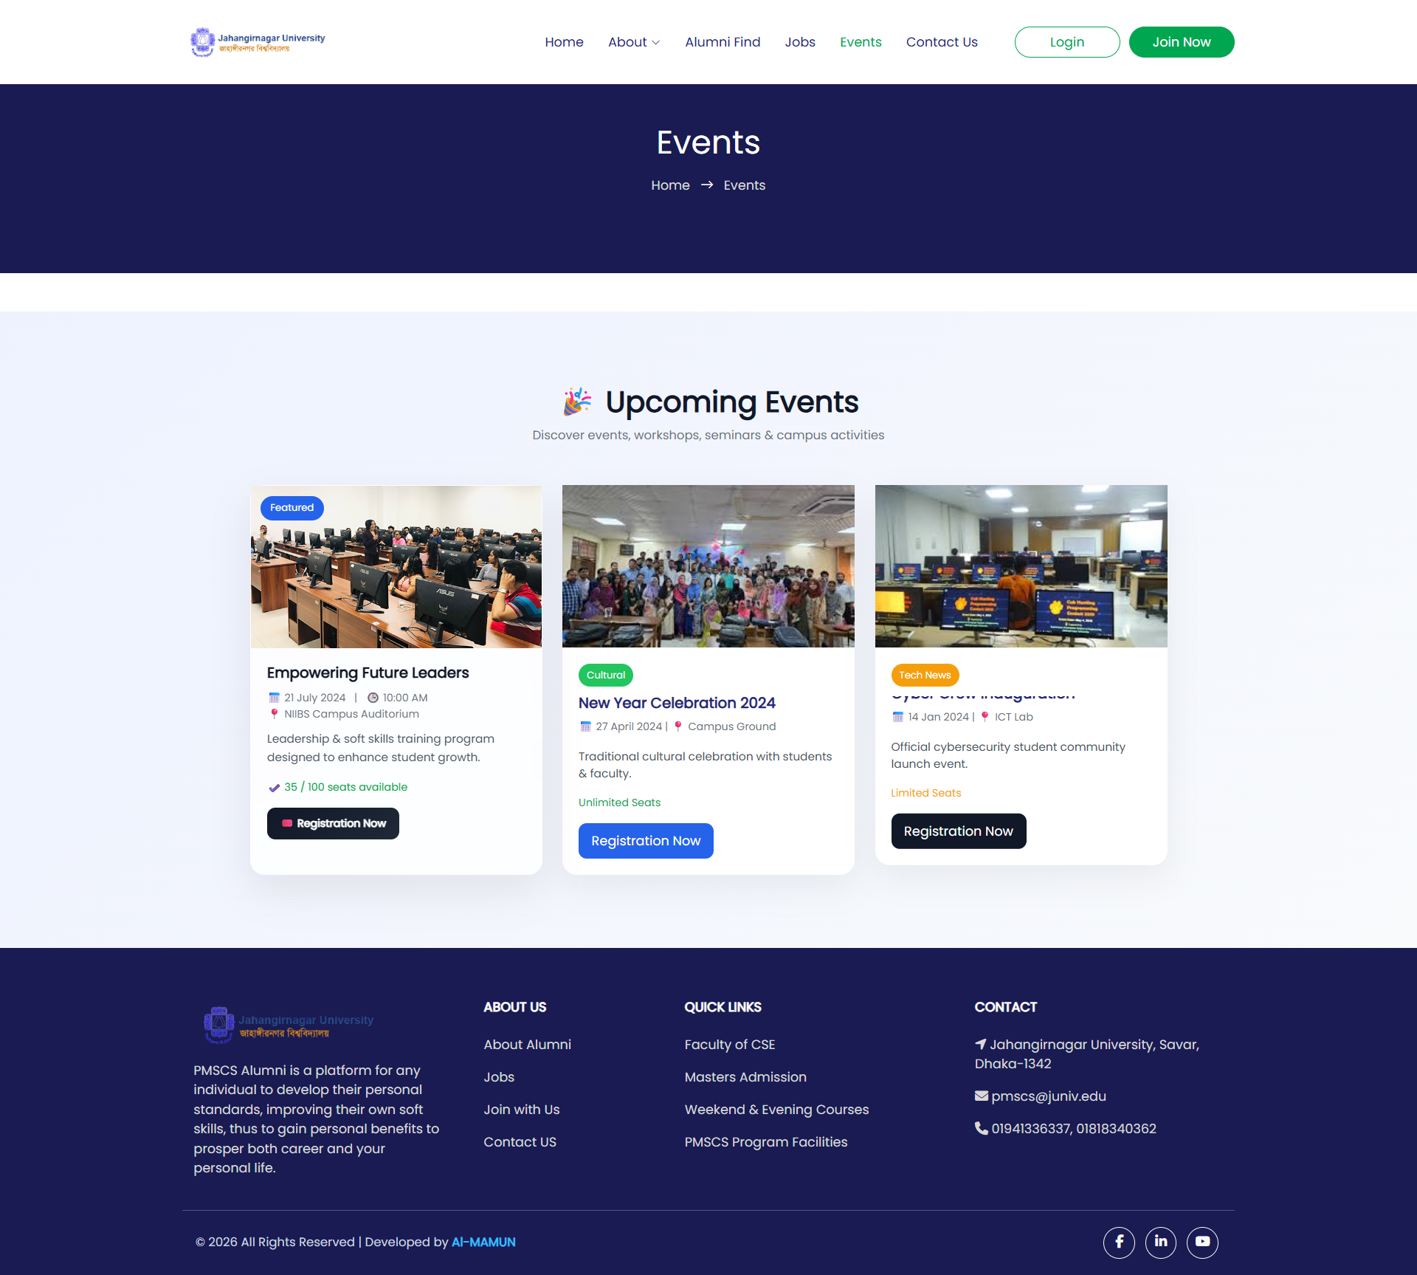
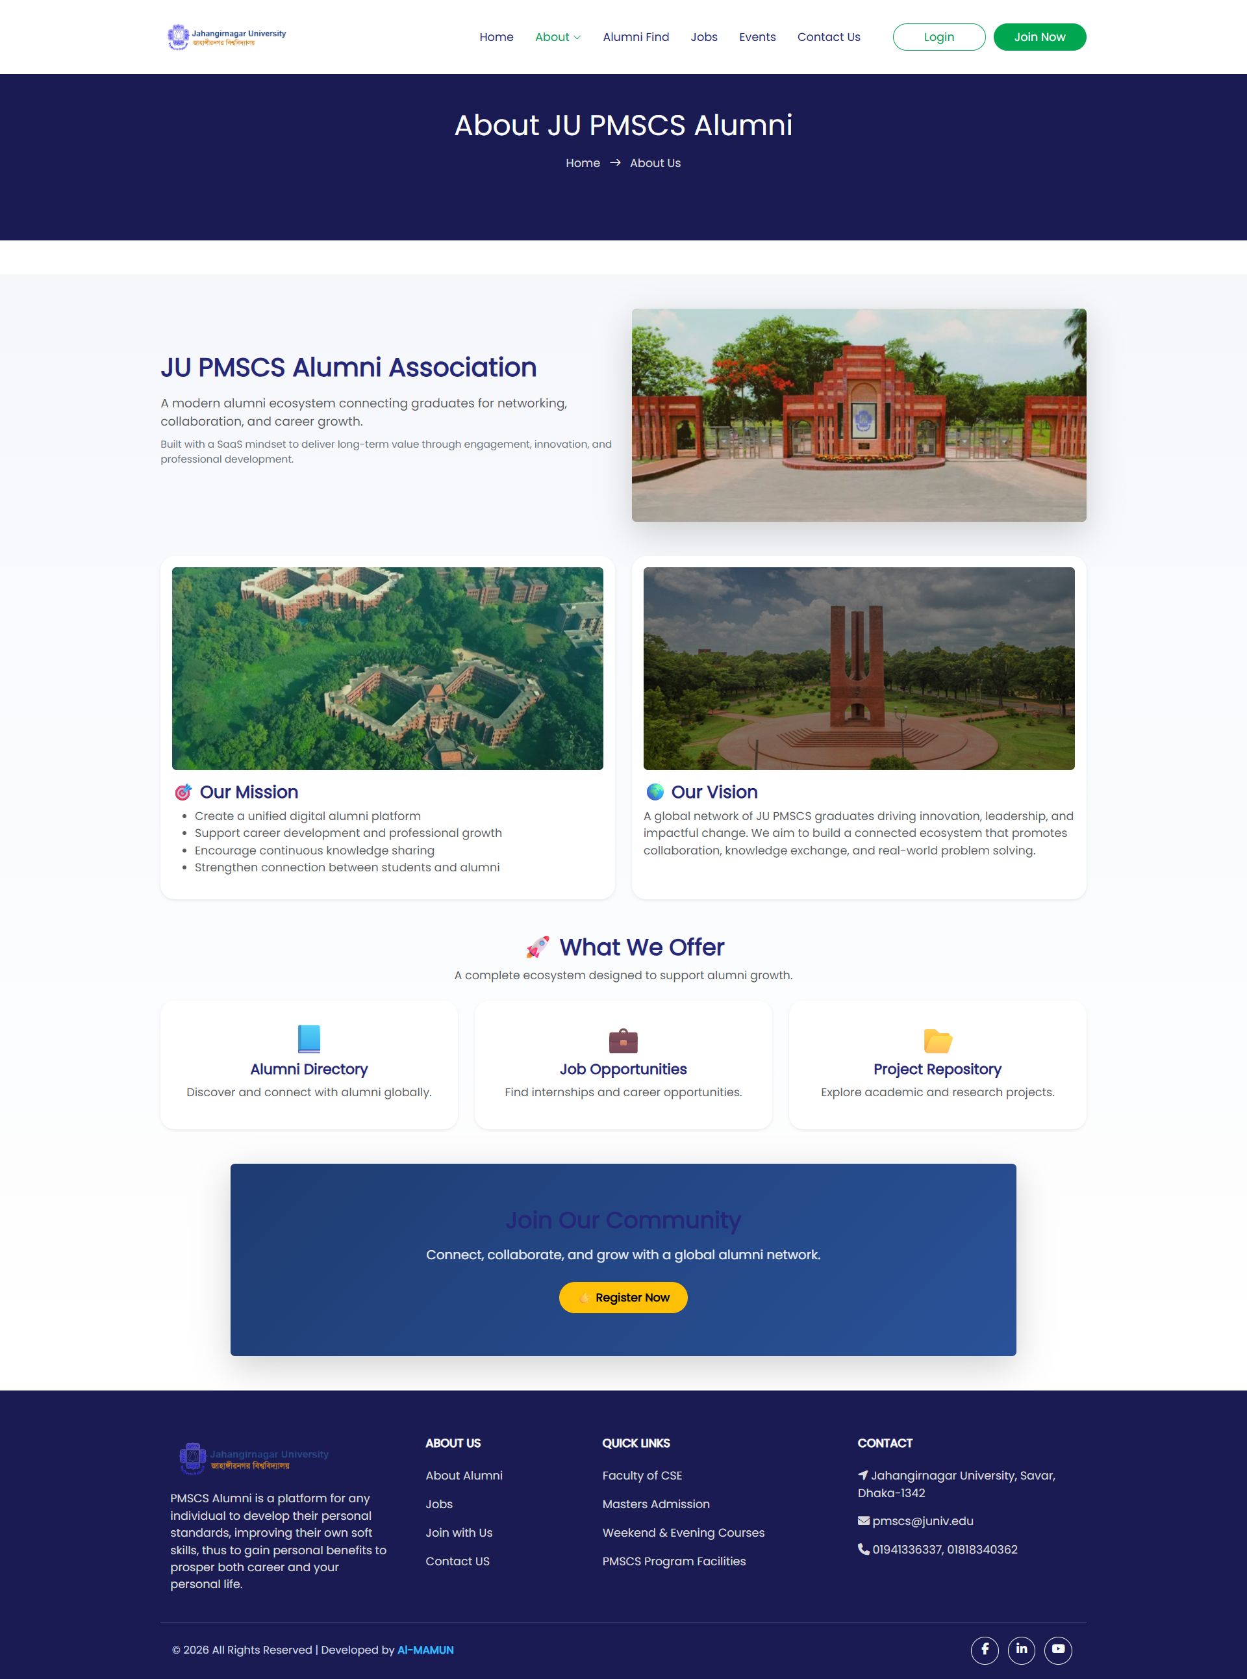
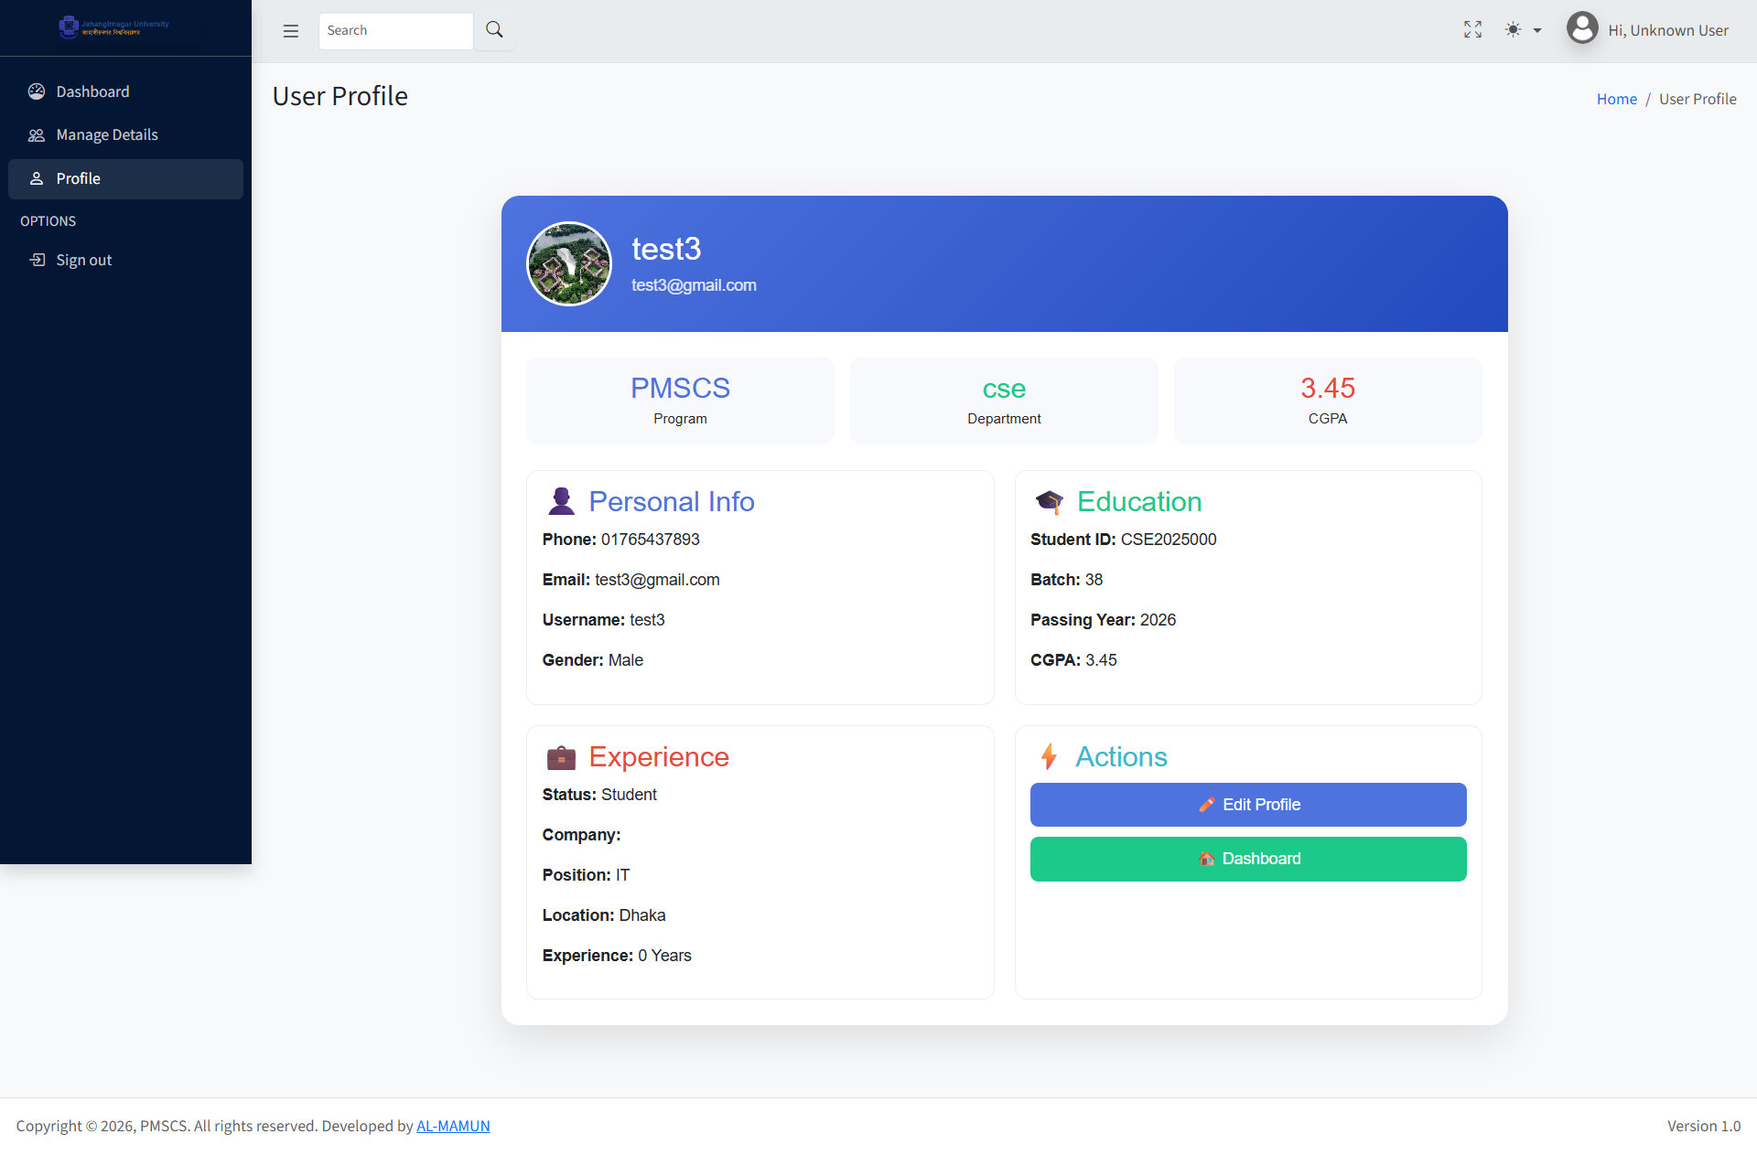
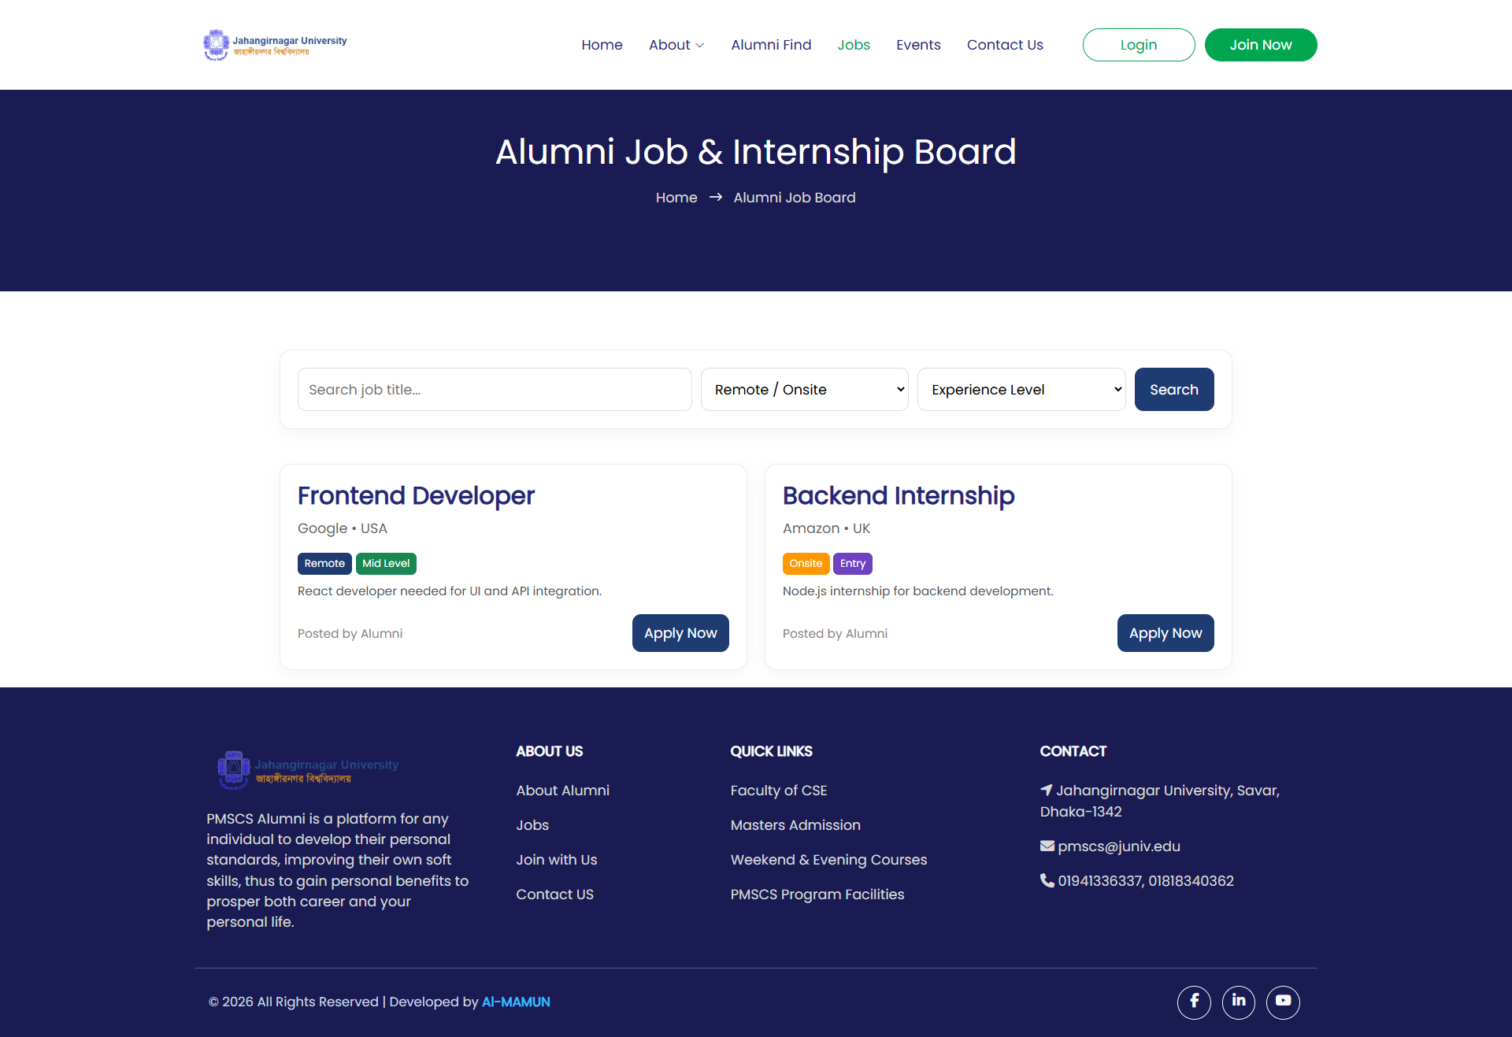
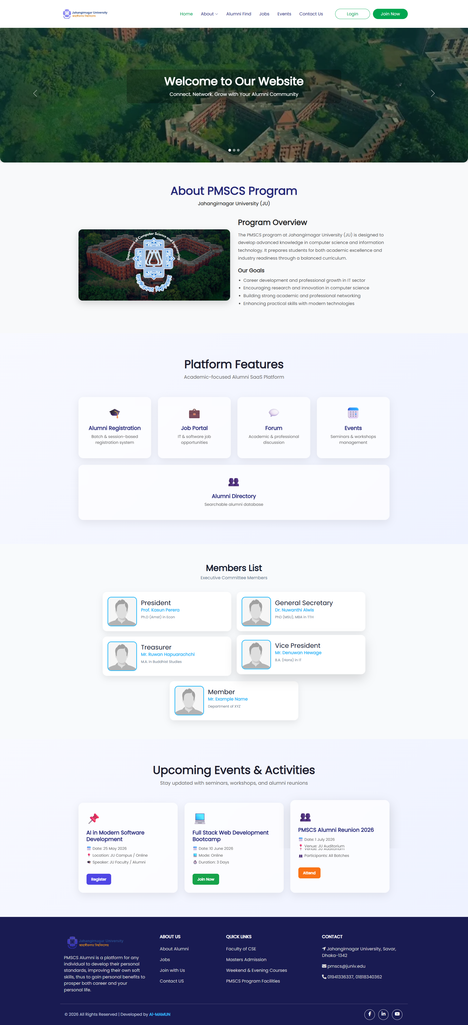
System Modules
Alumni Registration & Profile
Job Portal
Event Management
Alumni Directory
11/07/2026

Slide 12
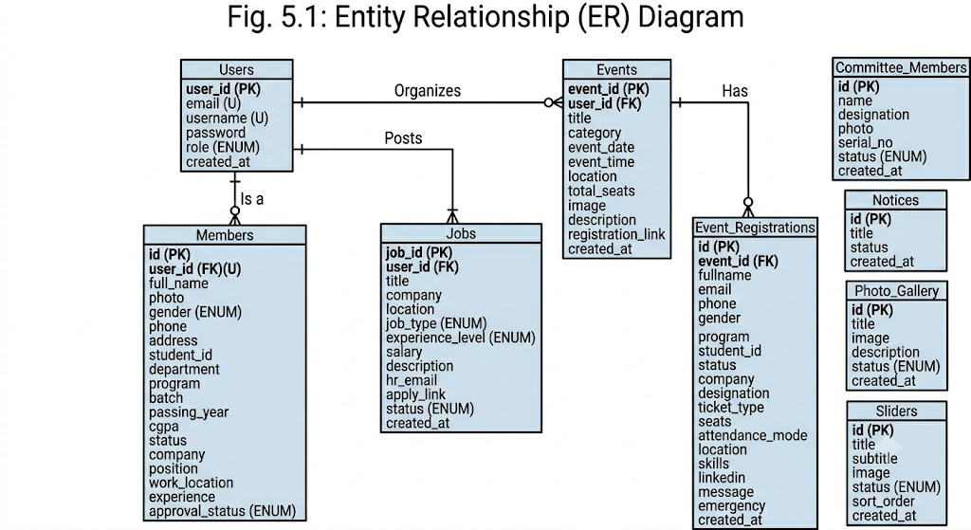
Database Design
11/07/2026

Slide 13
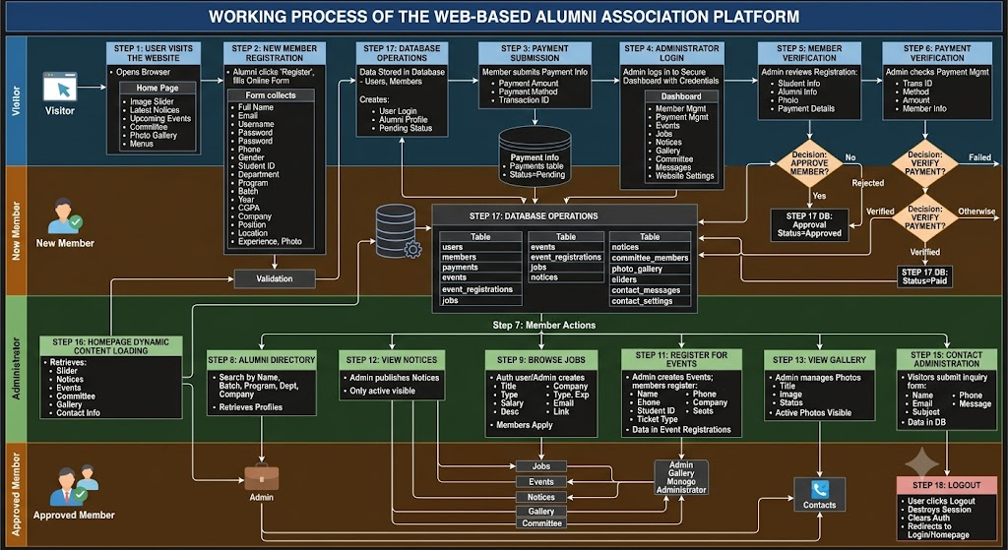
Working Process
11/07/2026

Slide 14
Discussion
Bridges communication gap between alumni and students
Improves job opportunity sharing
Provides centralized alumni database
Enhances usability and scalability
11/07/2026

Slide 15
Contributions & Significance
Practical Contribution:
A working alumni management system
Academic Contribution:
Full-stack web application implementation
Institutional Contribution:
Strengthens alumni-institution engagement
11/07/2026

Slide 16
Limitations
No mobile application version
Basic security implementation
Limited test dataset
11/07/2026

Slide 17
Conclusion & Recommendations
Conclusion
The project successfully developed a web-based alumni association platform.
It achieves centralized management of alumni data, jobs, and events.
The system improves communication between alumni and students.
Overall, it provides an efficient, scalable, and user-friendly solution for JU PMSCS.
Recommendations
Develop a mobile application for better accessibility.
Enhance security features (authentication and data protection).
Add email/SMS notification system for updates.
Integrate AI-based job recommendation in future versions.
Expand the system for other departments or universities.
11/07/2026

Slide 18
Future Work
Mobile application development
AI-based job recommendation system
Email and notification integration
Enhanced security mechanisms
11/07/2026

Slide 19
References
Bangladesh University of Business and Technology. Alumni network. https://www.bubt.edu.bd/alumni
Bangladesh AOTS Alumni Society. Alumni Society. https://www.baas.org.bd
Dhaka University Alumni Association. Dhaka University Alumni Association. https://www.duaa-bd.org
Green University of Bangladesh. Alumni Association. https://greenalumni.org
Jagannath University Alumni Association. Alumni Association. https://alumniist.jnu.ac.bd/
North South University Alumni Association. NSU Alumni Association. https://www.nsuaa.net
Rajshahi University Alumni Association. Alumni Association. https://www.ru.ac.bd/alumni/
University of Development Alternative. CSE Alumni Association. https://www.cseaa.uap-bd.edu/
University of Information Technology & Sciences. Alumni Association. https://alumni.uits.edu.bd
11/07/2026

Slide 20

Q&A / Thank You

